Slide 1
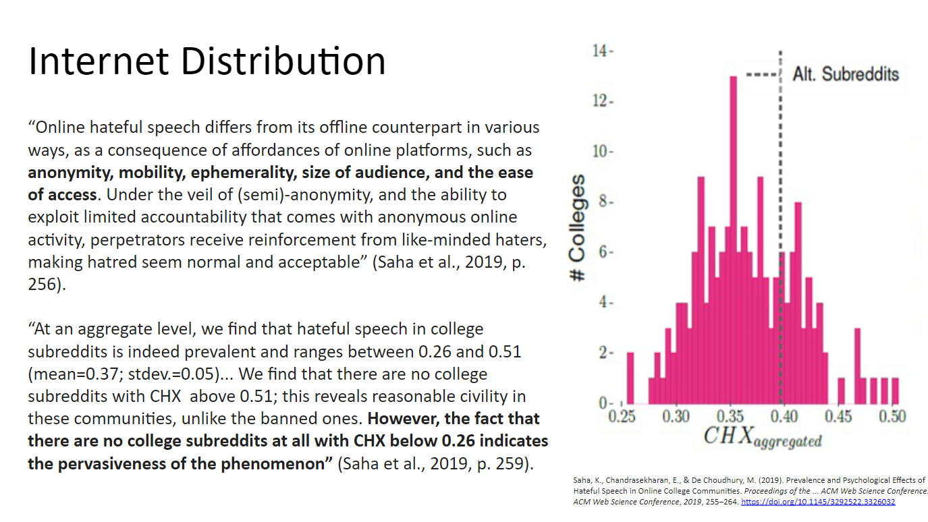
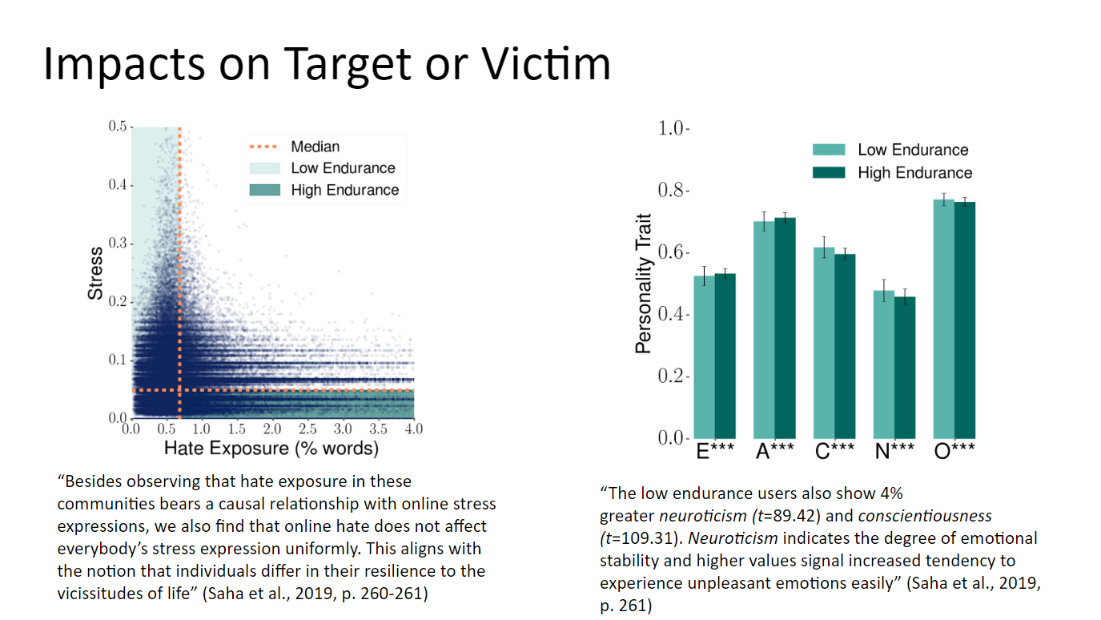
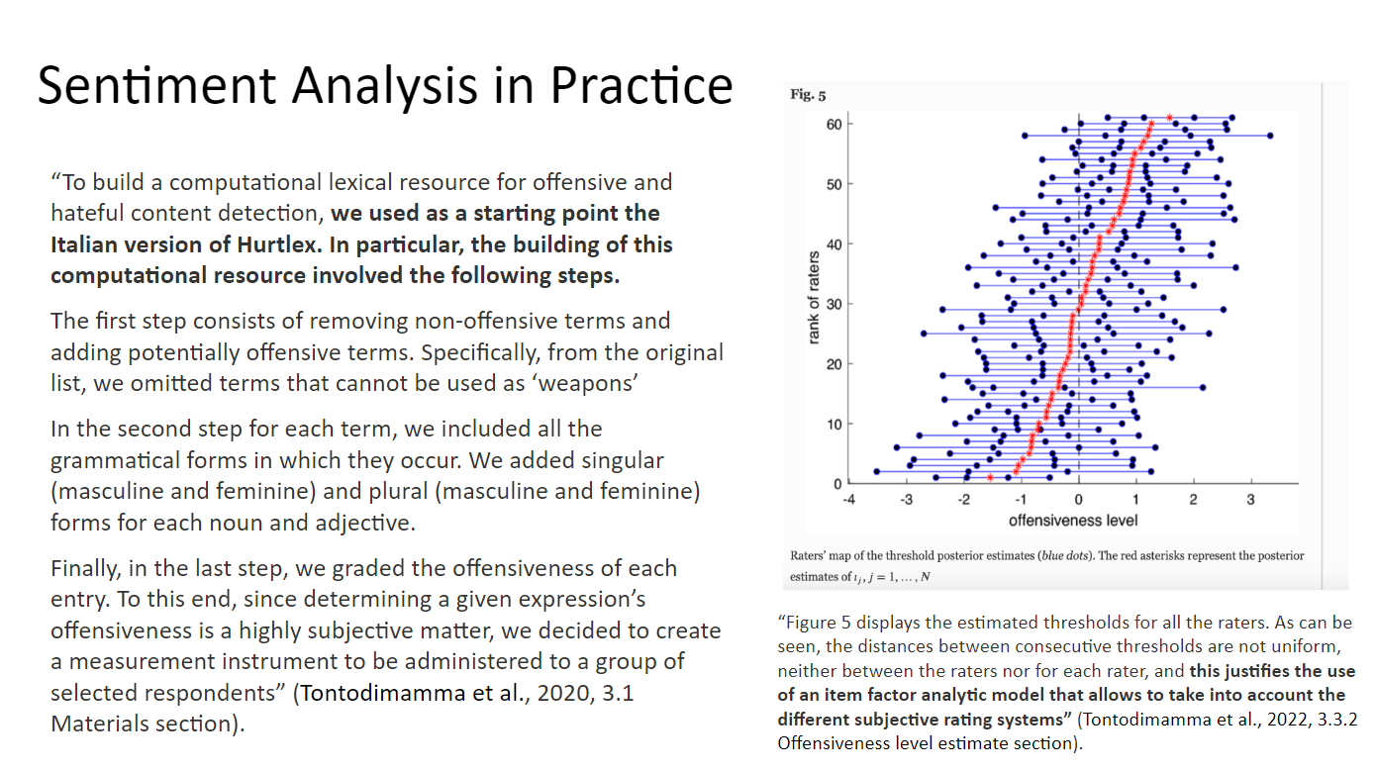
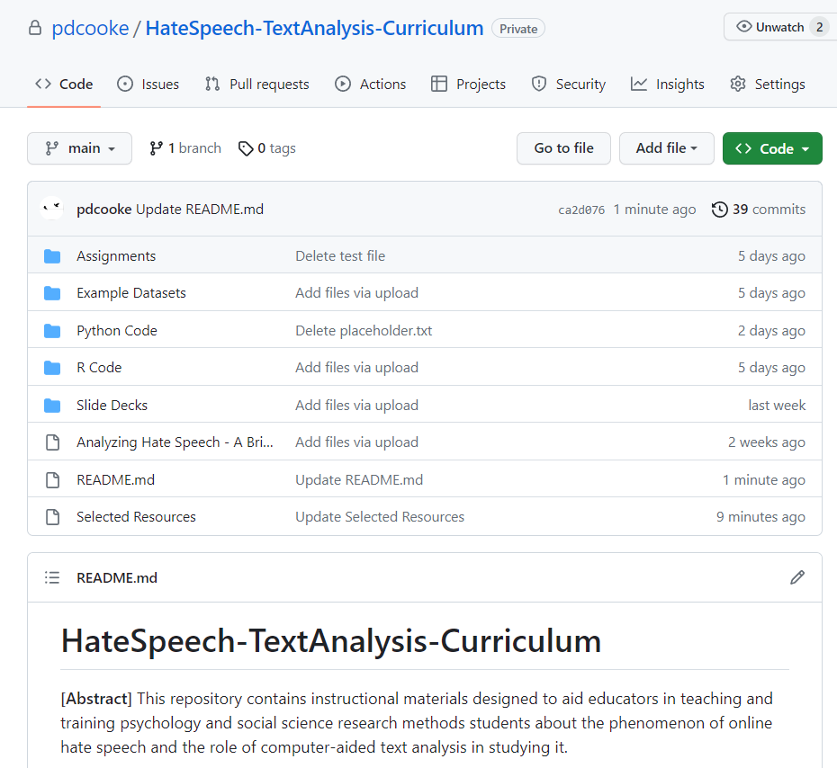
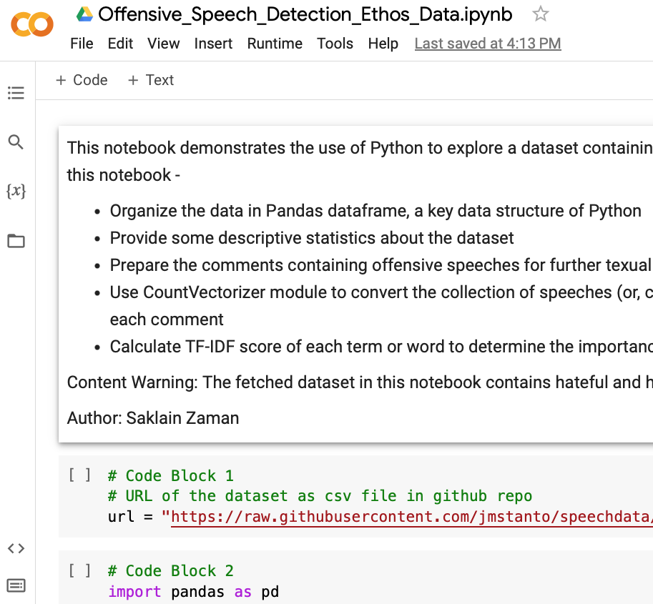
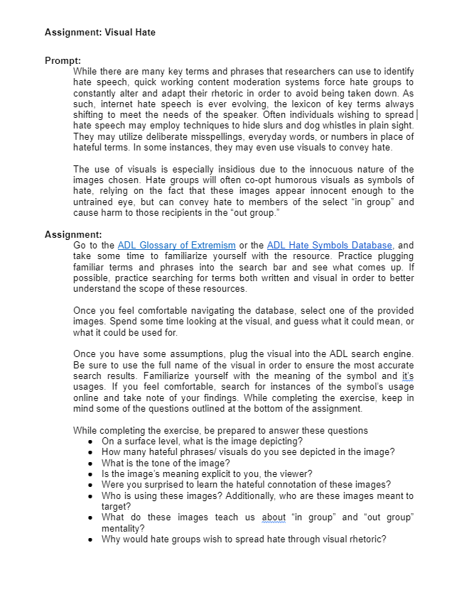
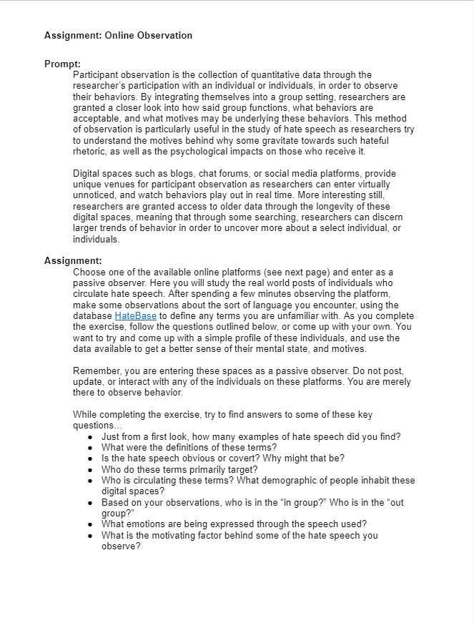
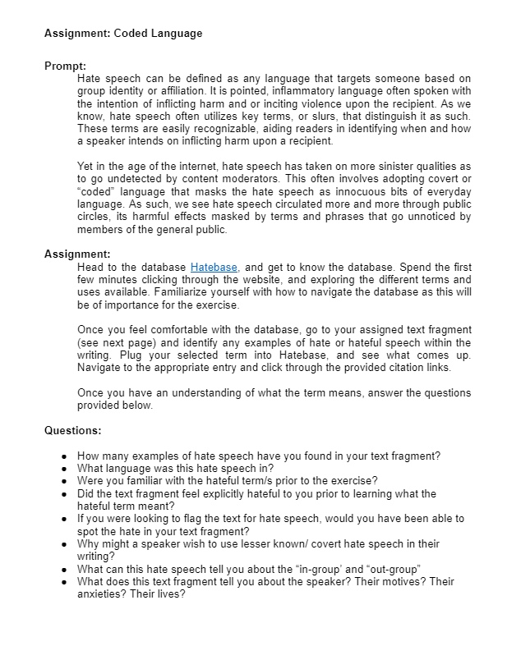
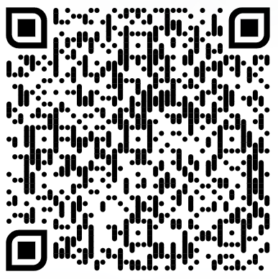
Curriculum and Technology for Enabling Student Research on Online Hate Speech*
Jeffrey M. Stanton, Ph.D. Emily M. Smith Payton D. Cooke
A Toolkit for Research Methods Instructors:
Hate speech represents an important social justice issue and a concern for many social media users
Psychology students learn experimental design and statistics, but training on computer-aided analysis of text is less common
Instructional support for basic text analysis enables faculty to include real data and analytical examples in course offerings
Toolkit contains modules about online hate speech suitable for a methods course or another course such as Psychology of Race
Data excerpts and tools for extracting speech examples from online forums enable data analysis using Jupyter notebooks
Prepared code illustrates analytic methods applicable to hate speech
Selected Curriculum, Code, and Classroom Exercises
Project Impact:
For psychology undergraduate students in the contemporary classroom, an instructional module focusing on online hate speech connects their coursework with a highly relevant, widely known social issue. Many students have direct experience with online examples of offensive speech. Learning how to analyze hate speech ties directly to the knowledge, skills, and outlooks that psychology faculty hope students will learn inside and outside of the classroom.
*This project was funded by a small grant from the APS Fund for Teaching and Public Understanding of Psychological Science.
The Github repository can be accessed here or at the following URL:
https://github.com/jmstanto/HateSpeech-TextAnalysis-Curriculum

